Slide 1
Employee Data Analysis using Excel
RIMISHA VARSHINI G P
STUDENT NAME:
REGISTER NO: 122204033
DEPARTMENT: lll B.COM (cs) ‘B’
COLLEGE : Shri Krishnaswamy college for women

Slide 2
PROJECT TITLE
Employee Performance Analysis using Excel

Slide 3


AGENDA
Problem Statement
Project Overview
End Users
Our Solution and Proposition
Dataset Description
Modelling Approach
Results and Discussion
Conclusion
3/21/2024 Annual Review

Slide 4

PROBLEM STATEMENT
Identifying gender in a company can serve several purposes:1. Diversity and Inclusion: Tracking gender helps companies monitor and improve gender diversity, ensuring a more inclusive workplace.2. Equal Opportunities: Gender identification helps ensure equal opportunities in hiring, promotions, and career development.3. Pay Equity: Analyzing gender helps identify potential pay gaps and ensures fair compensation practices.4. Workforce Planning: Understanding gender demographics informs workforce planning, talent development, and succession planning.5. Compliance: In some countries, companies are required to report gender demographics for regulatory compliance.6. Benchmarking: Companies can benchmark their gender diversity against industry averages or competitors.7. Creating Support Programs: Identifying gender helps companies develop targeted support programs, such as mentoring or employee resource groups.Remember, the goal is to promote diversity, equity, and inclusion, not to discriminate or stereotype. Gender identification should be used to create a more inclusive and equitable workplace.

Slide 5

PROJECT OVERVIEW
- Monitor and improve gender diversity and inclusion - Ensure equal opportunities in hiring, promotions, and career development - Identify and address potential pay gaps - Develop targeted support programs and resources - Comply with regulatory requirements Your participation in providing gender information is voluntary and confidential. We value and respect individual privacy and identity. The data collected will be used solely for aggregate reporting and analysis to support our diversity and inclusion initiation

Slide 6

WHO ARE THE END USERS?
The end users of gender identification in a company setting may include:1. HR Department: To monitor diversity metrics, ensure equal opportunities, and develop inclusive policies.2. Management and Leadership: To understand workforce demographics, make informed decisions, and promote diversity and inclusion.3. Diversity and Inclusion Teams: To develop targeted initiatives, support programs, and resources.4. Compliance Officers: To ensure regulatory compliance and reporting requirements.5. Researchers and Analysts: To study and analyze gender trends, gaps, and opportunities.6. Employee Resource Groups (ERGs): To support and advocate for employees with shared experiences and backgrounds.7. Business Leaders and Decision-Makers: To inform talent development, succession planning, and business strategy.8. Government Agencies and Regulatory Bodies: To comply with reporting requirements and regulations.These end users may utilize gender identification data to:- Develop inclusive policies and practices- Improve diversity and representation- Address pay gaps and equal opportunities- Create targeted support programs- Inform business decisions and strategy- Comply with regulations and reporting requirementsRemember, gender identification should always prioritize respect, privacy, and individuality.

Slide 7

OUR SOLUTION AND ITS VALUE PROPOSITION
Here's a potential solution and value proposition for gender identification:*Solution:* "Inclusive Insights" - A confidential and voluntary gender identification program that enables companies to collect, analyze, and act on gender diversity data.*Value Proposition:*1. *Accurate Diversity Metrics*: Gain a deeper understanding of your workforce's gender demographics to inform diversity initiatives.2. *Data-Driven Decision Making*: Use actionable insights to address gender disparities, improve equal opportunities, and develop targeted support programs.3. *Enhanced Inclusion*: Foster a more inclusive culture by acknowledging and valuing the diversity of your employees.4. *Compliance and Risk Management*: Ensure regulatory compliance and mitigate potential risks associated with gender discrimination.5. *Talent Attraction and Retention*: Demonstrate your commitment to diversity and inclusion, enhancing your employer brand and attracting top talent.6. *Business Outcomes*: Correlate gender diversity with business performance, driving innovation, collaboration, and revenue growth.*Key Features:*- Confidential and voluntary gender identification- Advanced analytics and reporting- Customizable dashboards and insights- Expert support and guidance- Integration with existing HR systemsBy implementing "Inclusive Insights," companies can unlock the full potential of their workforce, drive business success, and become leaders in diversity and inclusion.

Slide 8
Dataset Description
Here is a potential dataset description for gender identification:*Dataset Name:* Gender Identification Dataset*Purpose:* To collect and analyze data on gender demographics within an organization to support diversity, equity, and inclusion initiatives.*Variables:*1. *Employee ID* (unique identifier)2. *Gender* (self-identified): - Male - Female - Non-binary - Prefer not to disclose - Other (please specify)3. *Job Title*4. *Department*5. *Location*6. *Hire Date*7. *Job Category* (e.g., management, technical, administrative)8. *Level* (e.g., entry-level, mid-level, senior-level)*Additional Variables (optional):*1. *Age*2. *Ethnicity*3. *Sexual Orientation*4. *Disability Status**Data Collection Method:*- Voluntary and confidential online survey- HR system integration (for existing gender data)*Data Frequency:*- One-time collection- Quarterly or annual updates*Data Security:*- Data encrypted and stored securely- Access restricted to authorized personnel*Data Usage:*- Diversity and inclusion metrics- Equal opportunities monitoring- Pay equity analysis- Talent development and succession planning- Compliance reportingThis dataset description outlines the key variables, data collection methods, and usage guidelines for gender identification data. It ensures a clear understanding of the data's purpose, scope, and handling.

Slide 9

THE "WOW" IN OUR SOLUTION
*Data Quality*: Ensure data accuracy, completeness, and representativeness.
2. *Bias Mitigation*: Address potential biases in data collection, model development, and deployment.3. *Ethics and Transparency*: Prioritize model explainability, fairness, and transparency.4. *Regular Auditing*: Monitor model performance and retrain as necessary.
3/21/2024 Annual Review
9

Slide 10
MODELLING
*Data Quality*: Ensure data accuracy, completeness, and representativeness.
2. *Bias Mitigation*: Address potential biases in data collection, model development, and deployment.
3.*Ethics and Transparency*: Prioritize model explainability, fairness, and transparency.
4. *Regular Auditing*: Monitor model performance and retrain as necessary.
10

Slide 11
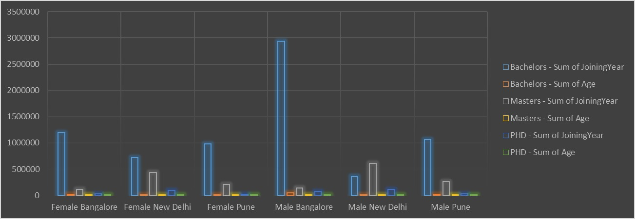
RESULTS
11

Slide 12
conclusion
"In conclusion, the identification of gender is a complex and multifaceted process that requires a thoughtful and inclusive approach. By recognizing the diversity of gender identities and experiences, organizations can create a more welcoming and equitable environment for all individuals. Through accurate self-identification, robust data analysis, and responsible modelling, organizations can:- Better understand their workforce demographics- Identify areas for improvement in diversity and inclusion- Develop targeted initiatives to address gender disparities- Foster a culture of inclusivity and respectBy prioritizing gender identification and analysis, organizations can unlock the full potential of their workforce, drive business success, and become leaders in diversity and inclusion. Remember, gender identification is not a one-time task, but an ongoing process that requires continuous effort, commitment, and dedication to creating a more inclusive workplace for all."

